Slide 1
CSE 477: Introduction to Computer Security
Lecture – 4
Course Teacher: Dr. Md Sadek Ferdous
Assistant Professor, CSE, SUST
E-mail: ripul.bd@gmail.com

Slide 2
Outline
Basic crypto concepts

Slide 3
Encryption
A means to allow two parties, customarily called Alice and Bob, to establish confidential communication over an insecure channel that is subject to eavesdropping

Slide 4
Encryption
The message M is called the plaintext
Alice will convert plaintext M to an encrypted form using an encryption algorithm E that outputs a ciphertext C for M

Slide 5
Encryption
As equations:
C = E(M), M = D(C)
The encryption and decryption algorithms are chosen so that it is infeasible for someone other than Alice and Bob to determine plaintext M from ciphertext C
Thus, ciphertext C can be transmitted over an insecure channel that can be eavesdropped by an adversary
The decryption algorithm must use some secret information known to Bob, and possibly also to Alice, but no other party
using an auxiliary input a secret number or string called decryption key
the decryption algorithm itself can be implemented by standard, publicly available software and only the decryption key needs to remain secret
Similarly, the encryption algorithm uses as auxiliary input an encryption key, which is associated with the decryption key
Unless it is infeasible to derive the decryption key from the encryption key, the encryption key should be kept secret as well

Slide 6
Cryptosystem
A cryptosystem consists of seven components:
The set of possible plaintexts
The set of possible ciphertexts
The set of encryption keys
The set of decryption keys
The correspondence between encryption keys and decryption keys
The encryption algorithm to use
The decryption algorithm to use

Slide 7
Cryptosystem: Caesar cipher
Replace each letter with the one “three over” in the alphabet
An example of a shift cipher
Can be denoted using the following formula:
s(c, k), here c represents one of 23 letters in Latin Alphabet and k represents the key
If k > 0, forward shift (encryption) and if k < 0, backward shift (decryption)
Example: s(A,3) = D, s(D,-3) = A
For Caesar cipher, {k=3} is the set of encryption key and {k=-3} is the set of decryption key
Uses modulo operation in a sort of circular shift fashion when shift goes beyond the limit

Slide 8
Symmetric key distribution
Symmetric crypto-systems are quite fast and efficient
However their main problem is key distribution
It requires each pair of communicating parties to share a (separate) secret key
If there are n parties, it means it requires a a total of n(n − 1)/2 keys

Slide 9
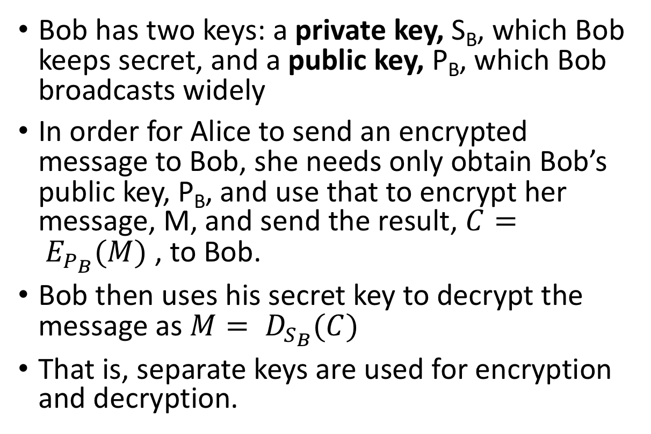
Public key cryptography
Bob has two keys: a private key, S_{B}, which Bob keeps secret, and a public key, P_{B}, which Bob broadcasts widely
In order for Alice to send an encrypted message to Bob, she needs only obtain Bob’s public key, P_{B}, and use that to encrypt her message, M, and send the result, $C= E_{P_{B}}(M)$ , to Bob.
Bob then uses his secret key to decrypt the message as $M= D_{S_{B}}(C)$
That is, separate keys are used for encryption and decryption.

Slide 10
Public key distribution
How many keys do we need to distribute for n users??

Slide 11
Public key distribution
Only one key is needed for each recipient!

Slide 12
Combining symmetric and public key systems
The main disadvantage of public-key cryptosystems is that they are much slower than existing symmetric encryption schemes
Hence, public-key cryptography is unsuitable for interactive sessions that use a lot of back-and-forth communication
Also, public-key cryptosystems have larger key lengths than that for symmetric cryptosystems
For example, RSA is commonly used with 2,048-bit keys while AES is typically used with 256-bit keys

Slide 13
Combining symmetric and public key systems
To work around these disadvantages,
public-key cryptosystems are often used in practice just to allow Alice and Bob to exchange a shared secret key,
Once exchanged, the shared secret key then can be used for communication encrypted with a symmetric encryption scheme

Slide 14
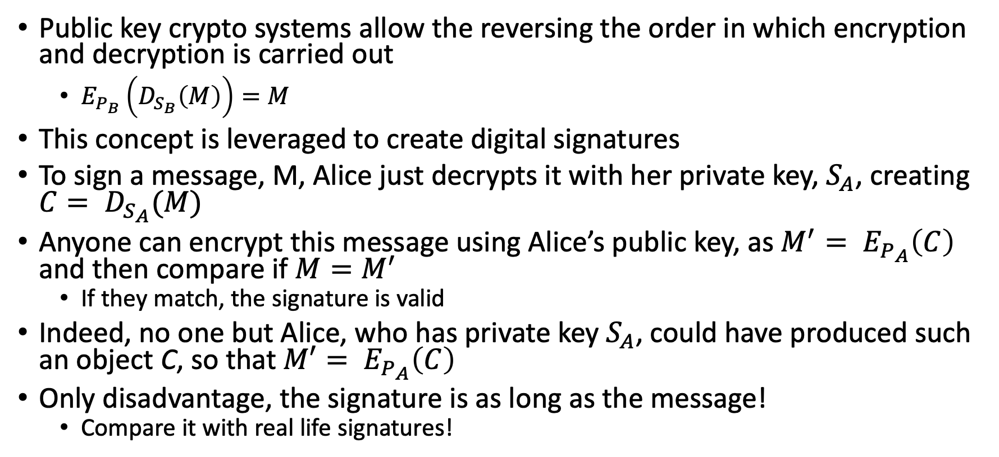
Digital signature
Public key crypto systems allow the reversing the order in which encryption and decryption is carried out
$E_{P_{B}}\left(D_{S_{B}}\left(M\right)\right)=M$
This concept is leveraged to create digital signatures
To sign a message, M, Alice just decrypts it with her private key, $S_{A}$, creating $C= D_{S_{A}}(M)$
Anyone can encrypt this message using Alice’s public key, as $M^{′}= E_{P_{A}}\left(C\right)$ and then compare if $M=M^{′}$
If they match, the signature is valid
Indeed, no one but Alice, who has private key $S_{A}$, could have produced such an object C, so that $M′= E_{P_{A}}\left(C\right)$
Only disadvantage, the signature is as long as the message!
Compare it with real life signatures!

Slide 15
Man In The Middle (MITM) Attack
Charlie is in the middle between Alice and Bob.
Charlie can:
View traffic
Change traffic
Add traffic
Delete traffic
Charlie could be:
Internet service provider
Virtual Private Network (VPN) provider
WIFI provider such as a coffee shop
An attacker re-routing your connection
An incompetent admin (it happens)

Slide 16
Simple attacks on crypto systems: MITM
The straightforward use of a cryptosystem presented, which consists of simply transmitting the ciphertext, assures confidentiality
However, it does not guarantee the authenticity and integrity of the message if the adversary can intercept and modify the ciphertext
How the recipient can be assured that the message s(he) receives is the intended one?
Man-In-The-Middle

Slide 17
Simple attacks on crypto systems: MITM
Bob (M, S) -> Eve (M’, S’) -> Alice??
Note that M′ will be different from the original message M
When Alice verifies the digital signature S′, she obtains message M′ by encrypting S’
Thus, Alice is led to believe that Bob has signed M′ instead of M
Note that in the above attacks the adversary can arbitrarily alter the transmitted ciphertext or signature
However, the adversary cannot choose, or even figure out, what would be the resulting plaintext since she does not have the ability to decrypt
Thus, the above attacks are effective only if any arbitrary sequence of bits is a possible message
This scenario occurs, for example, when a randomly generated symmetric key is transmitted encrypted with a public-key cryptosystem

Slide 18
Simple attacks on crypto systems: brute-force
How about brute forcing a crypto system?
Trying different probable keys over a cipher text to decrypt it to a meaningful text
Mind you, encryption and decryption functions are open, just the key is secret!
If the plaintext is an arbitrary binary string, this attack cannot succeed, as there is no way for the attacker to distinguish a valid message
However, if the plaintext is known to be text in a natural language, then the adversary hopes that only a small subset of the decryption results (ideally just a single plaintext) will be a meaningful text for the language

Slide 19
Brute force attack
Some knowledge about the possible message being sent will then help the attacker pinpoint the correct plaintext
Key should be a sufficiently long random value to make exhaustive search attacks unfeasible
Problem is it is usually easy to recognize that a message is a valid plaintext
For example, given a certain ciphertext, if an attacker could decrypt it with a given key and get message NGGNPXNGQNJABAVEIVARORNPU, which she can immediately dismiss
But if she gets message ATTACKATDAWNONIRVINEBEACH, then she can be confident she has found the decryption key
This ability is related to the unicity distance for a cryptosystem

Slide 20
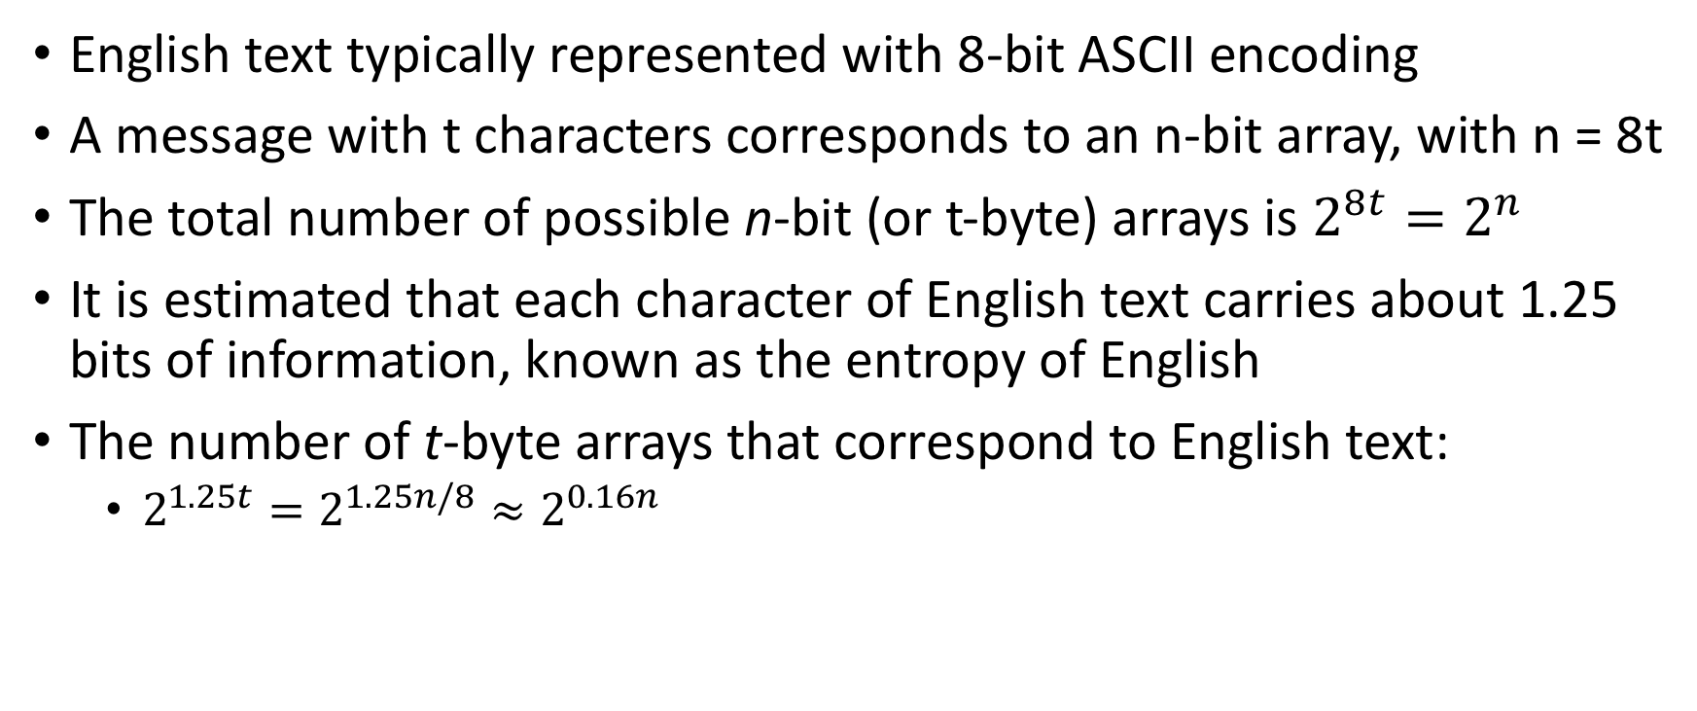
Brute force attack
English text typically represented with 8-bit ASCII encoding
A message with t characters corresponds to an n-bit array, with n = 8t
The total number of possible n-bit (or t-byte) arrays is $2^{8t}=2^{n}$
It is estimated that each character of English text carries about 1.25 bits of information, known as the entropy of English
The number of t-byte arrays that correspond to English text:
$2^{1.25t}=2^{1.25n/8}≈2^{0.16n}$

Slide 21
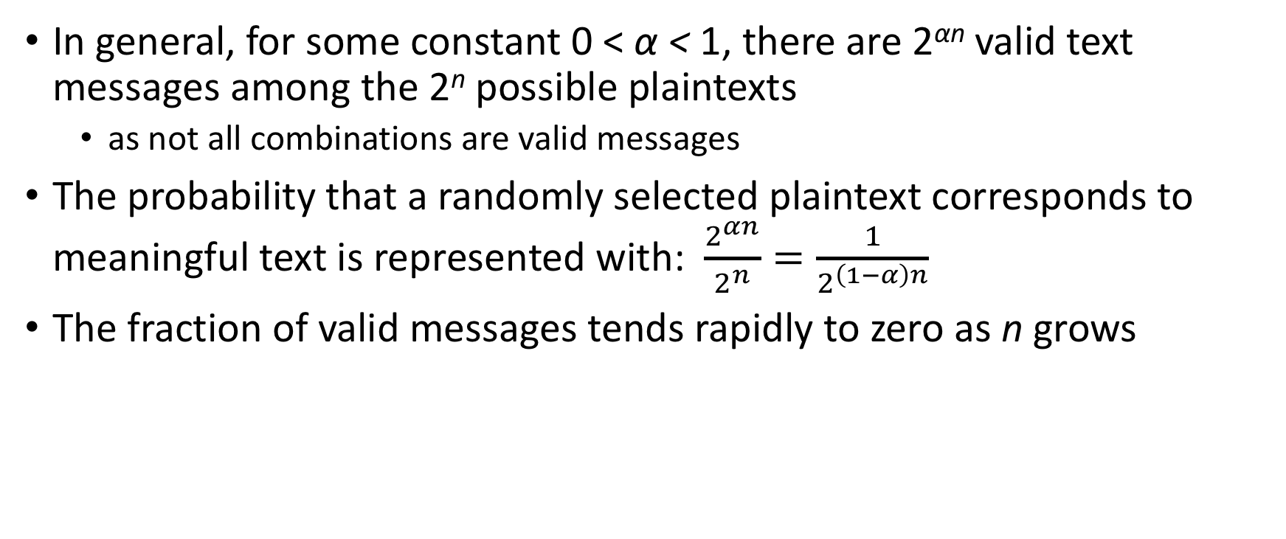
Brute force attack
In general, for some constant 0 < α < 1, there are 2^{αn} valid text messages among the 2^{n} possible plaintexts
as not all combinations are valid messages
The probability that a randomly selected plaintext corresponds to meaningful text is represented with: $\frac{2^{αn}}{2^{n}}=\frac{1}{2^{\left(1−α\right)n}}$
The fraction of valid messages tends rapidly to zero as n grows

Slide 22
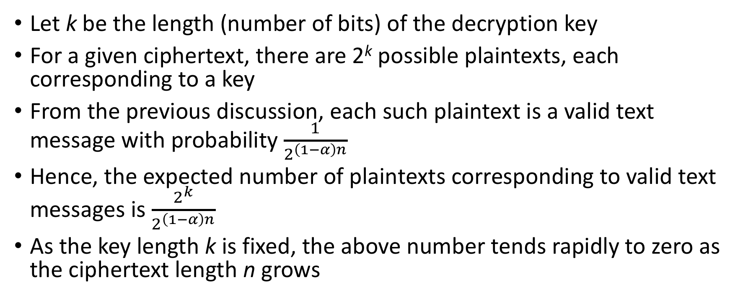
Brute force attack
Let k be the length (number of bits) of the decryption key
For a given ciphertext, there are 2^{k} possible plaintexts, each corresponding to a key
From the previous discussion, each such plaintext is a valid text message with probability $\frac{1}{2^{\left(1−α\right)n}}$
Hence, the expected number of plaintexts corresponding to valid text messages is $\frac{2^{k}}{2^{\left(1−α\right)n}}$
As the key length k is fixed, the above number tends rapidly to zero as the ciphertext length n grows

Slide 23
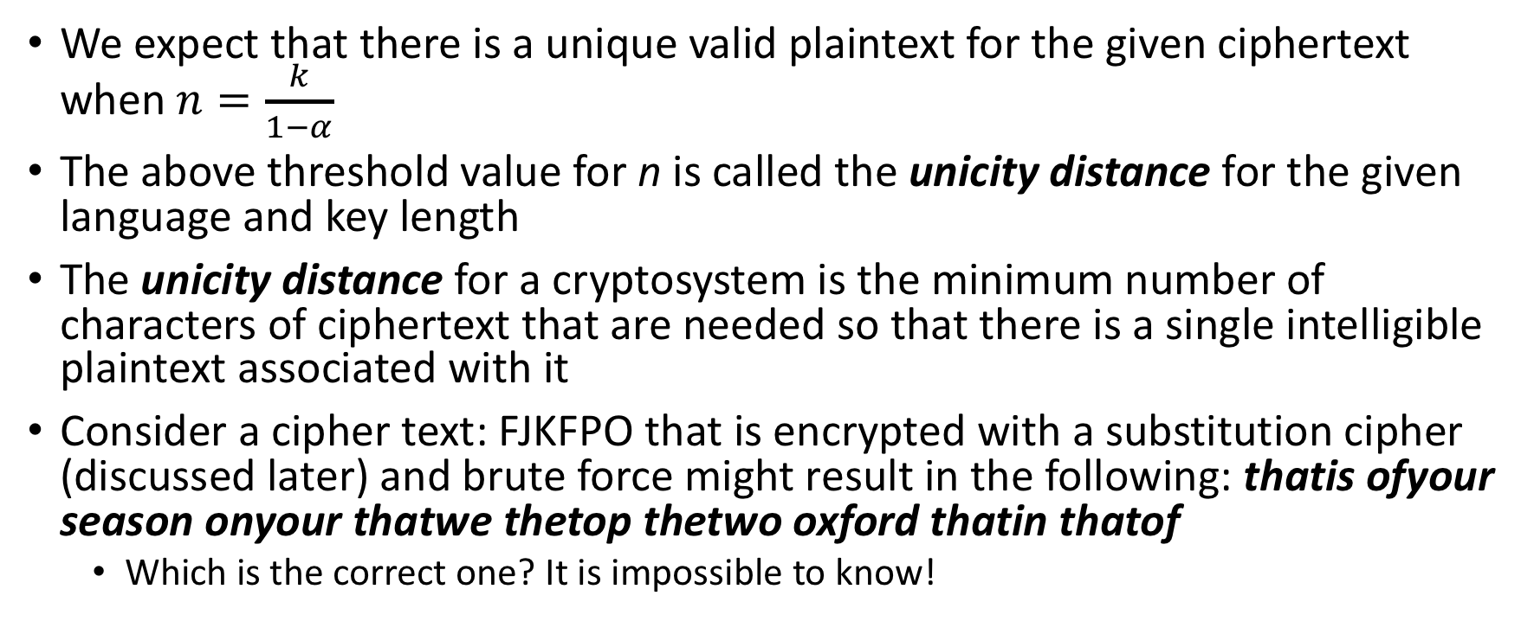
Brute force attack
We expect that there is a unique valid plaintext for the given ciphertext when $n=\frac{k}{1−α}$
The above threshold value for n is called the unicity distance for the given language and key length
The unicity distance for a cryptosystem is the minimum number of characters of ciphertext that are needed so that there is a single intelligible plaintext associated with it
Consider a cipher text: FJKFPO that is encrypted with a substitution cipher (discussed later) and brute force might result in the following: thatis ofyour season onyour thatwe thetop thetwo oxford thatin thatof
Which is the correct one? It is impossible to know!

Slide 24
Brute force attack
For the English language and the 256-bit AES cryptosystem, the unicity distance is about 304 bits or 38 ASCII-encoded characters
This is only half a line of text
We can conclude that brute-force decryption is likely to succeed for messages in natural language that are not too short
Namely, when a key yields a plaintext that is a meaningful text, the attacker has probably recovered the original message

Slide 25
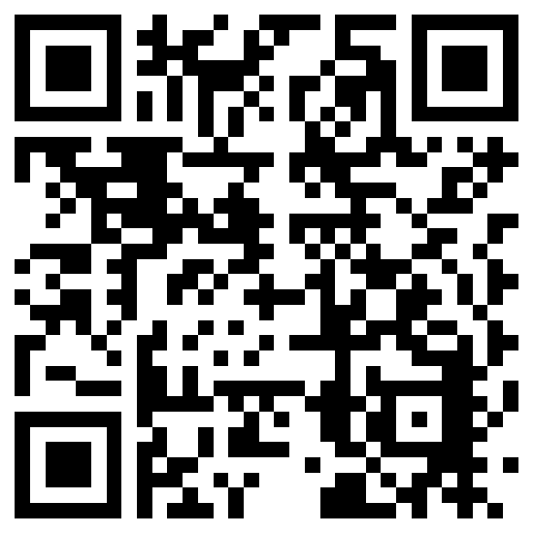
The lecture slides can be found in the following location!

